Slide 1
Optical communications and data networks (EENGM2001) Week14_Lecture014_ASync_Interferometers
Siddarth K Joshi

Slide 2
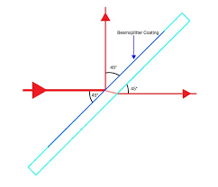
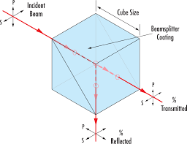
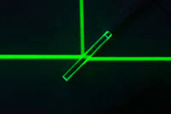
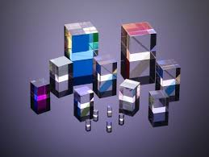
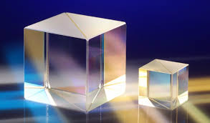
Beam Splitter
Optical device to change the direction of a fraction of the input power.
Not dependent on wavelength, polarisation, etc.
Only in the ideal case

Slide 3
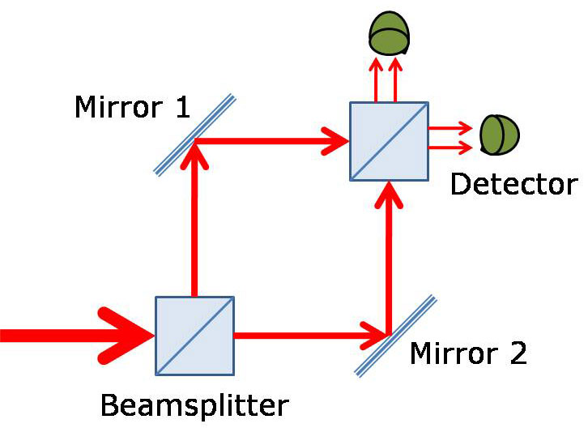
Mach–Zehnder interferometer
Simple
Use with EOM to modulate phase, amplitude
We already discussed this in Week13_Lecture007_Async_ ModulationDevices
Difficult to stabilise
Hard to change path length

Slide 4
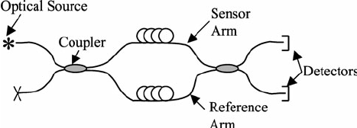
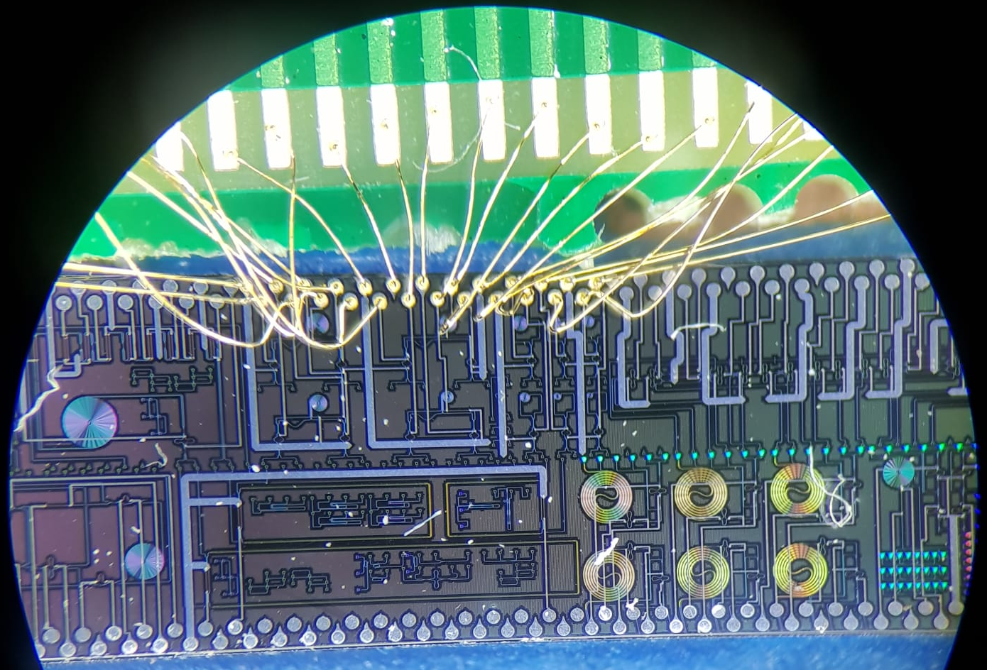
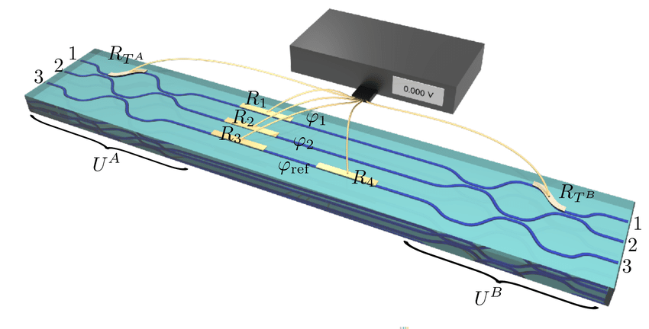
Mach–Zehnder interferometer
Can be built in fibre as well
Compare two fibres together
Extensive use in photonic technologies

Slide 5
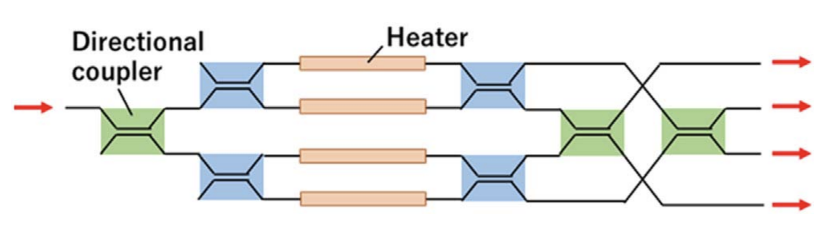
Mach–Zehnder interferometer
Used to build optical switches
Extensive use in photonic technologies
Japanese Journal of Applied Physics 59, SOOB04 (2020)https://doi.org/10.35848/1347-4065/ab8f09

Slide 6
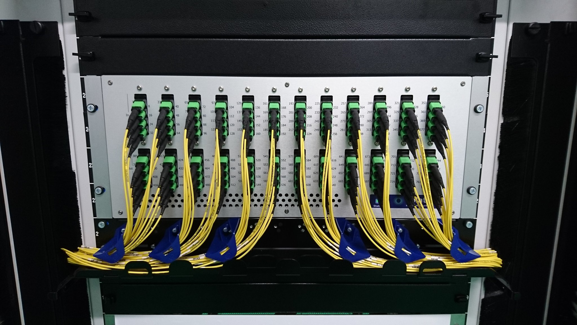
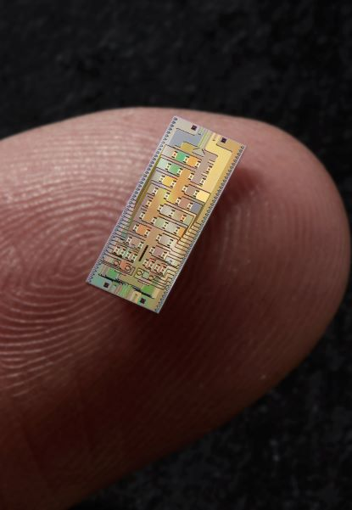
Mach–Zehnder interferometer
Photonic technologies:
Small size,
Low energy,
No mechanical parts
Reliable
Fast (<<us switching time)
Can also do all optical processing of information

Slide 7
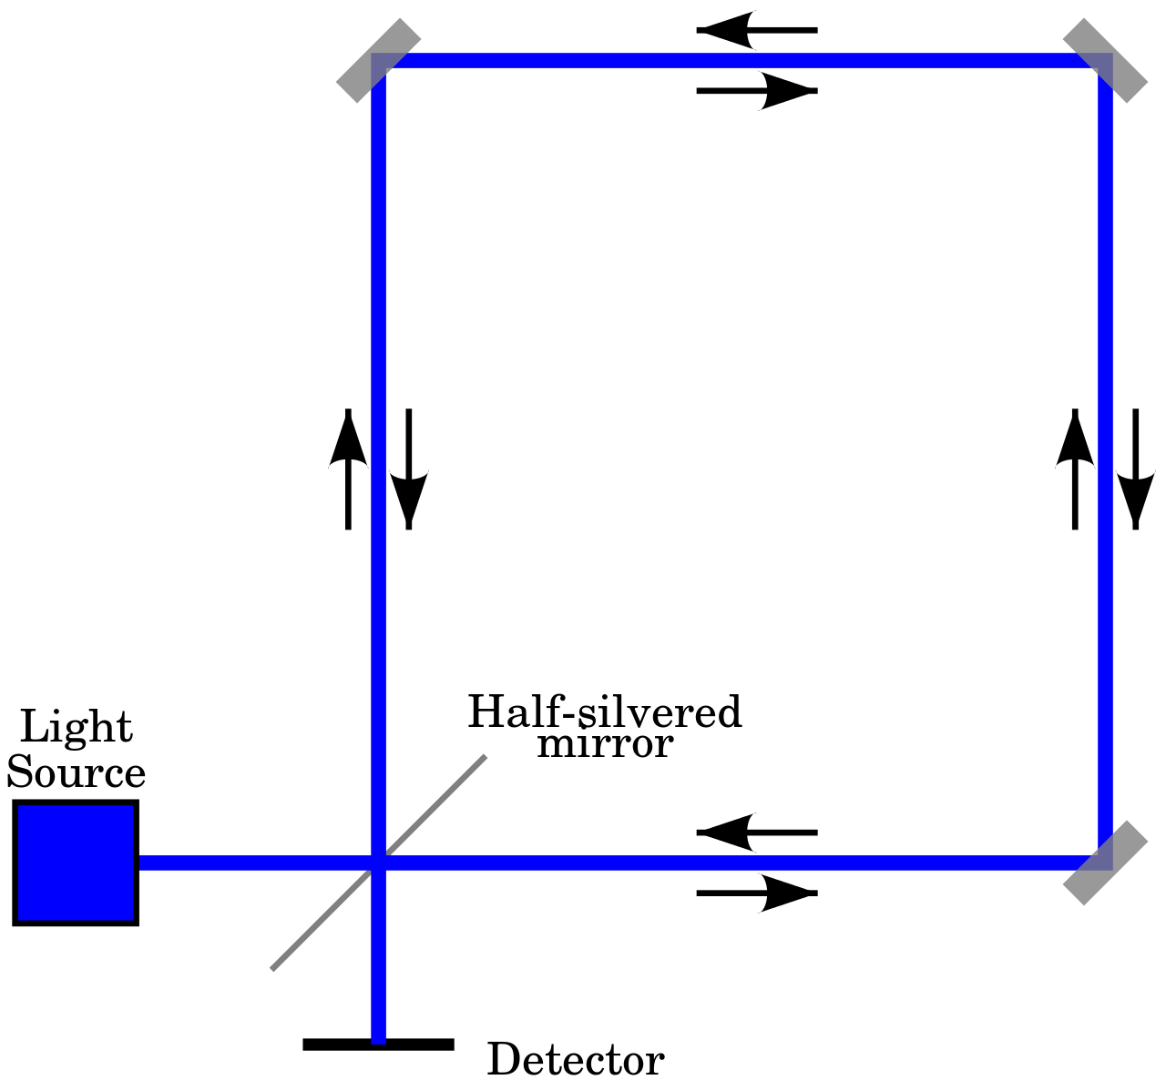
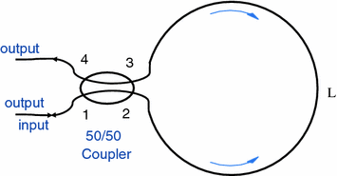
Sagnac Interferometer
Always phase stable, any vibration affects both paths.
Very easy to build

Slide 8
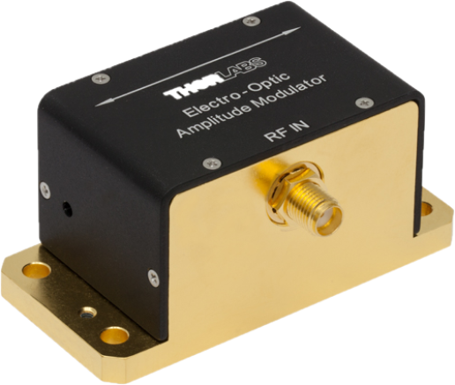
Sagnac Interferometer
Always phase stable, any vibration affects both paths.
Very easy to build in fibre and bulk
Converts phase modulation to amplitude
Used in sensing and navigation as well.

Slide 9
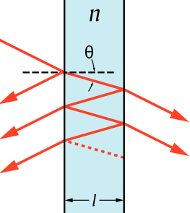
Cavity
Fabry–Pérot interferometer is a type of cavity
The mirrors can be two surfaces of a single material (Etalon) or two different mirrors.

Slide 10
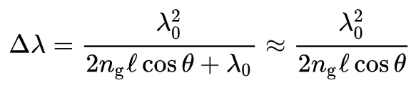
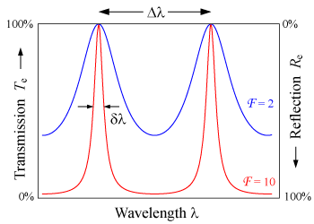
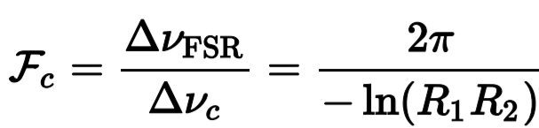
Cavity
Free spectral range =
Finesse =
Line width =

Slide 11
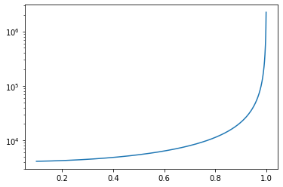
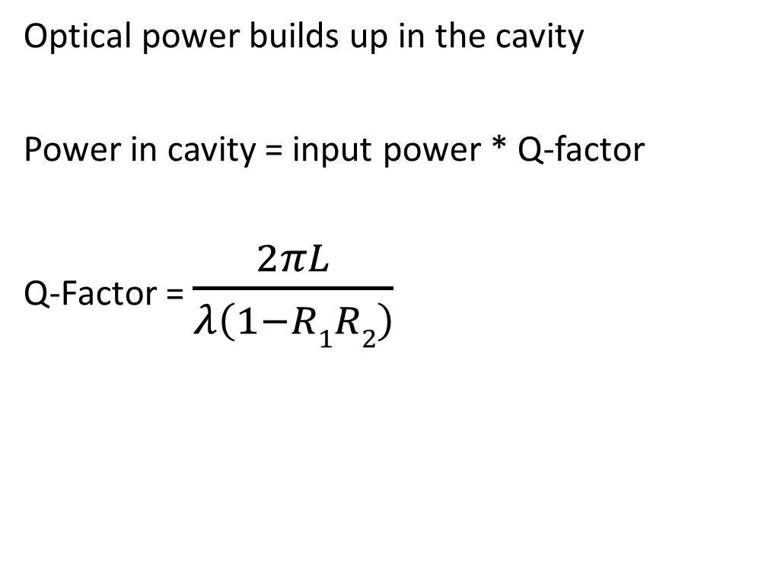
Cavity
Optical power builds up in the cavity
Power in cavity = input power * Q-factor
Q-Factor = $\frac{2πL}{λ\left(1−R1R2\right)}$
Q-Factor
Reflectivity
1mm spacing, 1550nm

Slide 12
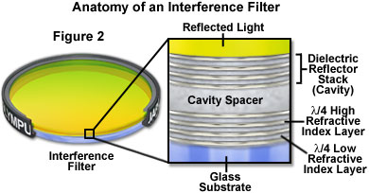
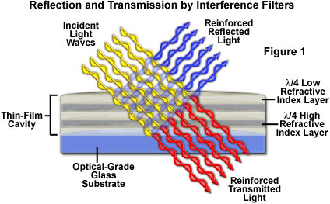
Cavity
Good for spectral filtering
Can also be made from thin films
nm thick layers deposited one by one to form cavities.

Slide 13
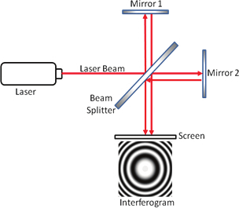
Michelson interferometer
Same principle as MZI
Folded path makes it easy to build.
Can measure laser coherence length (i.e. spectral linewidth)
Easy to change path length.
Main application: Optical interleaver

Slide 14
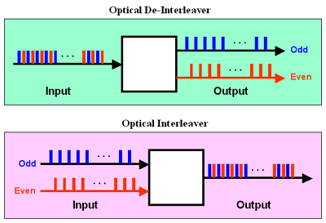
Optical Interleaver
Combines pulses with different timing into a single output stream
(a type of multiplexing)
Compresses the wavelength bandwidth of both signals to increase the capacity of the channel

Slide 15
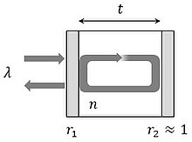
Optical Interleaver
Uses a Gires–Tournois etalon as one mirror of the Michelson interferometer
Gires–Tournois etalon:
High reflectivity for both surfaces
Causes a strong phase dependence on wavelength
Uses a Gires–Tournois etalon as one mirror of the Michelson interferometer
The exact workings of the interleaver are too complex for this course

Slide 16



Optical Interleaver
Uses a Gires–Tournois etalon as one mirror of the Michelson interferometer
Gires–Tournois etalon:
High reflectivity for both surfaces
Causes a strong phase dependence on wavelength

